Slide 1
Exiting the Integrated Master’s Program

Slide 2
Congratulations! You have made it to the end of your Integrated Master’s program! To ensure a seamless transition from INTO Suffolk to the university, please carefully review this presentation!
Course Objectives:
Learn about progression requirements and scholarships
Understand university academic expectations
Learn about student support resources and registration
Know key dates and deadlines for the upcoming semester

Slide 3
If you have any questions or concerns about exiting your program, please contact:
Claire Ingelfinger
Claire.ingelfinger@suffolk.edu
INTO Suffolk Academic Program Manager
Academic advisor for all students

Slide 4
LLM GRADUATE PROGRESSION REQUIREMENTS

Slide 5
LLM Graduate Students: Requirements for Progression to the University
2.9 or higher cumulative GPA (all semesters at INTO Suffolk)
No more than one grade of B- may be earned during your Integrated Master’s program; all other grades must be B or higher

Slide 6
SBS GRADUATE PROGRESSION REQUIREMENTS

Slide 7
SBS Graduate Students: Requirements for Progression to the University
3.0 cumulative GPA (all semesters at INTO Suffolk)
B or better in AE course(s)
B or better in SBS courses
If you finish your Integrated Master’s program with a cumulative GPA of 3.5 or higher, you are eligible for the progression scholarship - $2500 per semester! You must remain in good academic standing to maintain your scholarship.

Slide 8
CAS GRADUATE PROGRESSION REQUIREMENTS

Slide 9
CAS Graduate Students: Requirements for Progression to the University
3.0 cumulative GPA (all semesters at INTO Suffolk)
B or better in AE courses
Failure to meet the 3.0 progression requirement could result in dismissal from the university.

Slide 11
Academic Expectations at Suffolk University
You must maintain the required program GPA or higher each semester at Suffolk.
*If you fall below the minimum GPA, you will continue into next semester on academic probation. While on probation, you need to satisfy conditions outlined by your college (SBS or CAS) in order to continue at the university. Failure to maintain satisfactory academic performance could result in academic dismissal from the university!
You must practice ethical behavior in all Suffolk learning environments.
*Cheating, plagiarism, unauthorized collaboration, use of unauthorized electronic devices, self-plagiarism, fabrication or falsification of data and any other type of academic misconduct is a serious offense and could result in dismissal from the university.
Academic misconduct can be accidental! If you are unsure if you are acting in a way that is considered unethical at the university, ask your professor, or refer to the Student Handbook.

Slide 12
STUDENT RESOURCES & SUPPORT

Slide 14
FALL 2024 SEMESTER

Slide 15
Program Advisors
Abu Jalal: MSF
Gerard Casal: MSBA, MSM
Sarah Esner: MBA
Taisik Hwang: MAC
Bridgett Sandusky: LLM
Jason Peterson: MSA
Aki Morizono: MMOL

Slide 16
Learn more about Fall 2024 Classes! all meetings will occur from 2-3pm after today’s workshop
​
MSM – meet with Gerard Casal in room 5306 on the fifth floor of Sargent Hall​
MSBA – meet with Kimberley Zak in room 5205 on the fifth floor of Sargent Hall
MBA – meet with Sarah Esner in room 5309 on the fifth floor of Sargent Hall​
MMOL – meet with Aki Morizono in room 5312 on the fifth floor of Sargent Hall​
for all other programs, contact your program advisors to set up a meeting

Slide 17
Course Registration
You will register for your own fall 2024 courses since you will no longer be in the Integrated Master’s program.
If you have questions, you should work with your advisor
– check your Suffolk email for correspondence.

Slide 18
Course Registration FAQs
When should I register for next semester's courses?
Keep an eye on your email to learn your registration date and time though graduates should start on April 3
Where can I figure out what courses to take next semester?
View ALL available courses in Workday Student
Be sure the courses are directly applicable to your intended degree program; program advisors will help
How many credits do I need to take each semester?
You must be registered for 12 credits or more in order to be a full-time student
This is required for your F-1 visa!
If you are not registered for 12 or more credits, it may be because you are on a course's waitlist. While you wait, you should register for a back-up course/section so you show as full-time status. You can add/drop courses if you are able to add your waitlisted course.
If you are on a course's waitlist, you should check your Suffolk email daily to see if and when you are eligible to add the course.

Slide 19
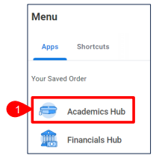
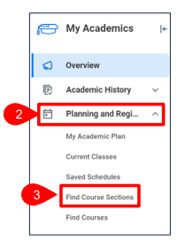
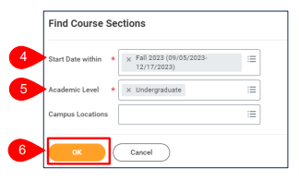
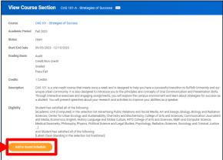
How Course Registration Actually Works
Log in to Workday Student and go to the Academics Hub
Follow the links to Planning and Registration and Find Course Sections
Be sure you are searching in the correct semester and academic level (Fall 2024 and Graduate)
Using the search bar, find the recommended courses for the fall semester
Add them to your saved schedule
Once registration opens, register for the classes
Watch this video for helpful hints!
Notes:
Video should start at 2:50 for course sections (beginning part is from academic plan and I’m not sure if all students have that in their workday)

Slide 20
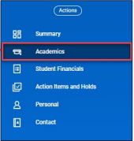
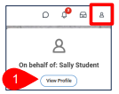
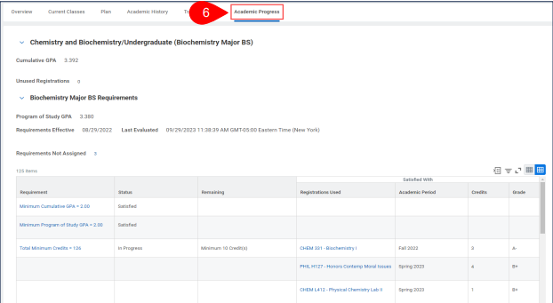
How to Stay Ahead of the Curve
In Workday Student, a lot of important information is included in the Academics Tab; start with your student profile and navigate from there
To understand the courses needed for your degree program, navigate to academic progress
Unsure how to use this tool? Watch this short video!

Slide 21
Important Fall Dates
Make sure to always refer to the Academic Calendar for important dates and breaks!
September 4: Fall day classes begin
September 10: last day to register for fall classes
September 24: last day to drop a fall class
October 14: October break – University closed
November 4: spring and summer registration starts
November 11: Veteran's Day observed – University closed
November 27 - November 29: Thanksgiving break – University closed
December 9: last day of fall classes for SBS and CAS
December 11 - December 17: Final exams week
December 19: fall 2024 grades due

Slide 22
Important Spring Dates
Make sure to always refer to the Academic Calendar for important dates/deadlines!
January 15: Martin Luther King Day – university closed
January 16: spring classes begin
January 23: last day to register for spring 2024 classes
February 19: Presidents’ Day – university closed
March 11-March 15: spring break – classes canceled
April 1: fall 2024 registration starts
April 15: Patriots’ Day – university closed
April 29: last day of spring classes
April 30-May 7: final exams
May 9: grades available to students

