Slide 1
Exiting the International Year One (IYO) Program

Slide 2
Congratulations! You have made it to the end of your IYO program! To ensure a seamless transition from the IYO program to the university, please carefully review the information in this presentation.
Today's Objectives:
Learn about progression requirements and scholarships
Understand university academic expectations and Honors Programs
Learn about student support resources and registration
Know key dates and deadlines for the upcoming semester

Slide 3
If you have any questions or concerns about exiting your IYO program, please contact:
Claire Ingelfinger
INTO Suffolk Academic Program Manager
Academic advisor for all INTO Suffolk students
Reach me by email: claire.ingelfinger@suffolk.edu
Sign up for an appointment through Navigate
Drop on by Room 4047!

Slide 4
IYO PROGRESSION REQUIREMENTS

Slide 5

Requirements for Progression to the University
2.0 cumulative GPA (all semesters of IYO program)
Pass all of your EAP courses

Slide 6
What Happens If I Don’t Meet
Progression Requirements?
The academic standing committee meets after final grades are submitted to discuss the case.
You could either:
Be placed on probation or academic warning
Be required to extend your IYO program
Be dismissed from the university
Notes:
Probation: will have to extend and meet progression requirements or dismissal from the university is likely

Slide 7
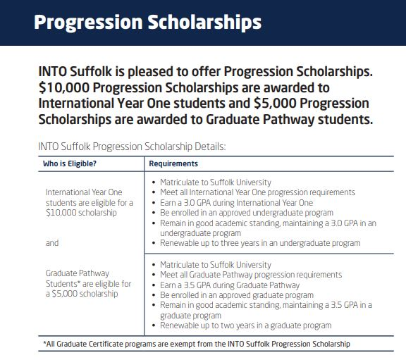

Slide 8
Academic Expectations at Suffolk University
You must maintain a 2.0 GPA or higher each semester at Suffolk.
*If you fall below a 2.0 GPA, you will continue into the next semester on academic probation. While on probation, you need to satisfy conditions outlined by your college (SBS or CAS) in order to continue at the university. Failure to maintain satisfactory academic performance could result in academic dismissal from the university!
You must practice ethical behavior in all Suffolk learning environments.
*Cheating, plagiarism, unauthorized collaboration, use of unauthorized electronic devices, self-plagiarism, fabrication or falsification of data and any other type of academic misconduct is a serious offense and could result in dismissal from the university.
Academic misconduct can be accidental! If you are unsure if you are acting in a way that is considered unethical at the university, ask your professor, or refer to the Student Handbook.

Slide 9
Suffolk University Honors Program
• The CAS Honors Community Scholars program (for freshmen and sophomores), the Honors in the Major program (for juniors and seniors) and the SBS Honors program welcome applications from INTO Suffolk students who have completed the INTO program with a GPA of 3.5 or above and one additional full-time semester with a semester GPA of 3.5 or above. Candidates for the honors program should have no grades of D, F, or I; and should be in good standing with Suffolk University. They should have no disciplinary actions with the Dean of Students’ Office, and should not have been found responsible for any violations of the Academic Misconduct Policy.
• Interested and qualified students should apply to the director of the honors program for their school after the Fall 2024 semester to join the program in Spring 2025.
CAS students - Assistant Dean Lenzie, slenzie@suffolk.edu
SBS students – Assistant Dean Larkin, klarkin@suffolk.edu
• For more information about the honors program, check out SBS Honors Program or the CAS Honors Community Scholars Program.

Slide 10
STUDENT
RESOURCES &
SUPPORT

Slide 11
Instructor Office Hours
refer to syllabus for days/times/locations
Writing Center Tutoring
English Language Workshops
Drop-in whenever you are available
In-person, in various locations throughout campus
Content Tutoring
(Including Math and Stats)
Drop-in and by appointment (it depends on the course!)
In-person and via Zoom (it depends on the course!)
Academic Coaching
By appointment
In person or online via Zoom
In-person and online
Log in through Navigate or visit the 9th floor of 73 Tremont
Previous Topics: reading comprehension; peer conversation; vocab and pronunciation; professional communication
Chat with Orla Downey or learn more here
Interested? Find out more here
Click here to learn how to be a better writer
Academic Advising
The staff of the Undergraduate Academic Advising Center (UAAC) can assist until you are assigned a major advisor
Click here for more information or to make an appointment

Slide 12
FALL 2024

Slide 13
Course Registration
You will register for your own Fall 2024 courses since you will no longer be in the IYO program. If you have not done so already, be sure to speak with Claire about recommended classes.
If you have an immunization, documents or finance hold on your account, you will not be able to register. Please get all holds cleared before registration starts on April 11.
Have questions?? Come to the third floor computer lab for extra help during the IYO Registration Workshop on Friday, April 12th from 2-4pm.

Slide 14

Confirming Your Major
You should have already declared a major. If you wish to change it before your progression, please contact Claire.
A major can be changed at any time throughout your time at Suffolk though you should make sure you understand each degree’s requirements and how they fit in to your overall career goals
  Undergraduate academic advising can always help with those conversations
All undergraduate majors at Suffolk:
• College of Arts & Sciences Majors
• Sawyer Business School Majors

Slide 15

Course Registration FAQs
  When should I register for next semester's courses?
    You should have already started to create a saved schedule in Workday student for your fall classes (summer courses are optional)
    Keep an eye on your email to learn your registration date and time (around April 11)
    Where can I figure out what courses to take next semester?
    View ALL available courses in Workday Student
    Be sure the courses are directly applicable to your major or overall degree
How many credits do I need to take each semester?
  You must be registered for 12 credits or more in order to be a full-time student
    This is required for your F-1 visa!
  If you are not registered for 12 or more credits, it may be because you are on a course's waitlist. While you wait, you should register for a back-up course/section so you show as full-time status. You can add/drop courses if you are able to add your waitlisted course.
  If you are on a course's waitlist, you should check your Suffolk email daily to see if and when you are eligible to add the course.

Slide 16
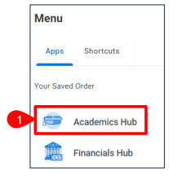
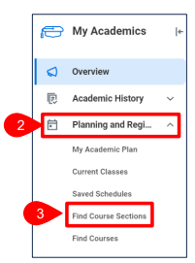
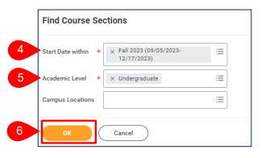
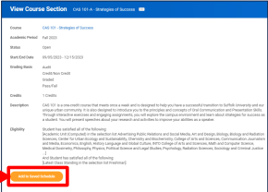
How Course Registration Actually Works
Log in to Workday Student and go to the Academics Hub
Follow the links to Planning and Registration and Find Course Sections
Be sure you are searching in the correct semester and academic level (Fall 2024 and Undergraduate)
Using the search bar, find the recommended courses for your next semester’s studies
Add them to your saved schedule
Once registration opens, register for the classes!
Watch this video for helpful hints!
Notes:
Video should start at 2:50 for course sections (beginning part is from academic plan and I’m not sure if all students have that in their workday)

Slide 17
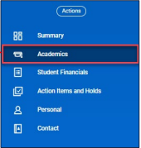
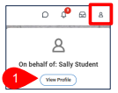
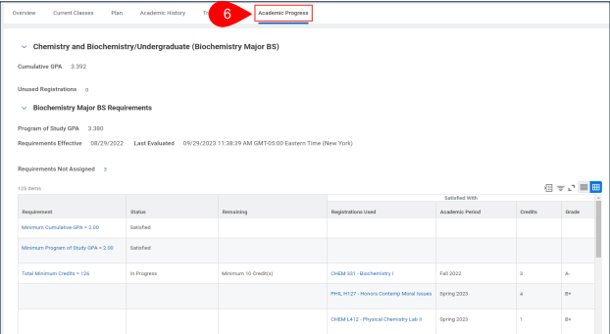
How to Stay Ahead of the Curve
In Workday Student, a lot of important information is included in the Academics Tab; start with your student profile and navigate from there
To understand the courses needed for your degree program, navigate to academic progress
  Unsure how to use this tool? Watch this short video!

Slide 18



Important Summer Dates
Summer 24 Module 1 Semester
May 13: Summer module 1 begins
June 28: Last day of summer module 1 classes
Summer 24 Module 2 Semester
July 1: Summer module 2 classes begin
August 16: Last day of summer module 2 classes
Summer 24 Module A Semester
May 13: Summer module A begins
August 16: Last day of summer module A classes
Grades are viewable on August 21 at 2pm
University Closed/No Classes
May 27: Memorial Day
June 19: Juneteenth
July 4: Independence Day

Slide 19



Important Fall Dates
Make sure to always refer to the Academic Calendar for important dates and breaks!
September 4: Fall day classes begin
September 10: last day to register for fall classes
September 24: last day to drop a fall class
October 14: October break – University closed
November 4: spring and summer registration starts
November 11: Veteran's Day observed – University closed
November 27 - November 29: Thanksgiving break – University closed
December 9: last day of fall classes for SBS and CAS
December 11 - December 17: Final exams week
December 19: fall 2024 grades due

Slide 20
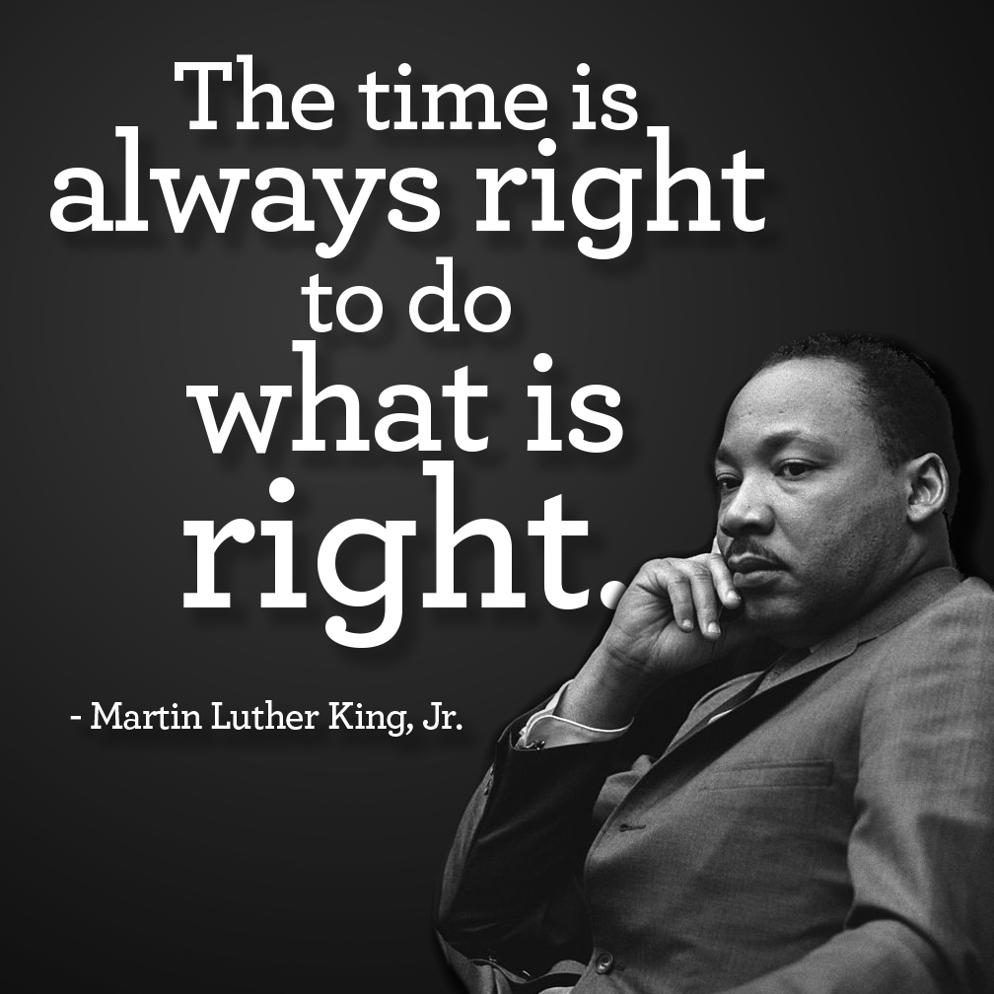

Important Spring Dates
Make sure to always refer to the Academic Calendar for important dates/deadlines!
January 15: Martin Luther King Day – university closed
January 16: spring classes begin
January 23: last day to register for spring 2024 classes
February 19: Presidents’ Day – university closed
March 11-March 15: spring break – classes canceled
April 1: fall 2024 registration starts
April 15: Patriots’ Day – university closed
April 29: last day of spring classes
April 30-May 7: final exams
May 9: grades available to students

