Slide 1
Equity-Minded Teaching Practices: Race/Ethnicity-Conscious Student Engagement
TOPIC: Examining how we welcome, engage with, and build relationships with our students

Slide 2
Workshop Overview
Learn how to conduct a race-conscious classroom engagement assessment
Do you have racialized patterns of student engagement?
Start to unpack values and beliefs
How do you make sense of these patterns?
Learn different ways to engage with all students to build equity
Notes:
what explanations do I give myself to make sense of engagement outcomes?

Slide 3
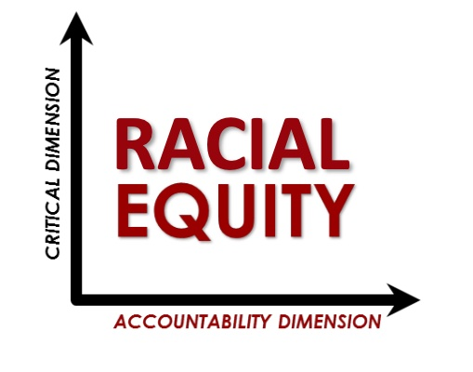
Racial Equity
Defining Racial Equity
The Accountability and Critical Dimensions
Bensimon & Associates (2021) Racial Equity Data Discovery Workshop
Notes:
Racial equity is not only a “nice” or “good” thing to do, it is also about the institution being accountable for producing racially equitable outcomes.

Slide 4
Defining Racial Equity
Proportional representation of historically marginalized groups in educational outcomes (e.g., admissions, access, retention, degree completion)
Bensimon & Associates (2021) Racial Equity Data Discovery Workshop
Notes:
Refers primarily to data, and one way to talk about data is proportionality, or a proportional representation of historically marginalized groups in educational outcomes (e.g., access, retention, degree completion) and participating in enriching experiences

Slide 5
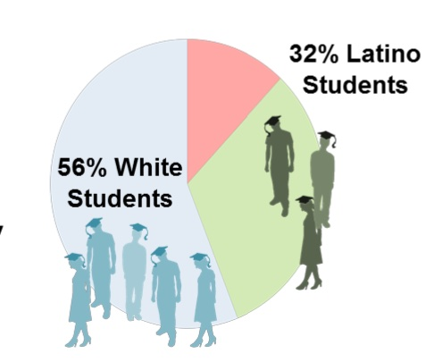
= Equity
Proportion of Entering Student Population
Proportion of Graduating Student Population
Bensimon & Associates (2021) Racial Equity Data Discovery Workshop
Notes:
You’d expect the same proportion of entering students will be represented in the population of graduating students. And this is not always the case. We can also look at proportionality in our classrooms – in grades and in participation. So we need to use the group of students as their own benchmark, rather than comparing them to each other, or to white students.

Slide 6
Defining Racial Equity
Recognition that institutional racism and bias are characteristic of colleges and universities that must be dismantled with strategies that are race conscious
Bensimon & Associates (2021) Racial Equity Data Discovery Workshop
Notes:
The other dimension of racial equity is the critical dimension, and this is the recognition that institutional racism is an entrenched characteristic of colleges and university, and this has to be dismantled with strategies that are color conscious, informed by critical race theory, and systemic. Racism is not only an individual action or behavior, but the most serious is that which lives in our institutional structures and processes that are invisible.

Slide 7
Equity-Mindedness
Practitioner awareness of racial identity
Practitioner awareness of racialized patterns
Practitioner reflection on racial consequences of actions
Practitioner agency and willingness to produce racial equity
Bensimon & Associates (2021) Racial Equity Data Discovery Workshop
Notes:
Equity mindedness entails: practitioner awareness of racial identity (see some things and not see other things), practitioner awareness of racialized patters (in a syllabus, gradebook, or who is in the classroom), practitioner reflection on racial consequences of actions, and practitioner agency to produce racial equity (power of position, networks, knowledge) and we choose who we use them for – sometimes we use our power to reward some who do not need more rewards

Slide 8
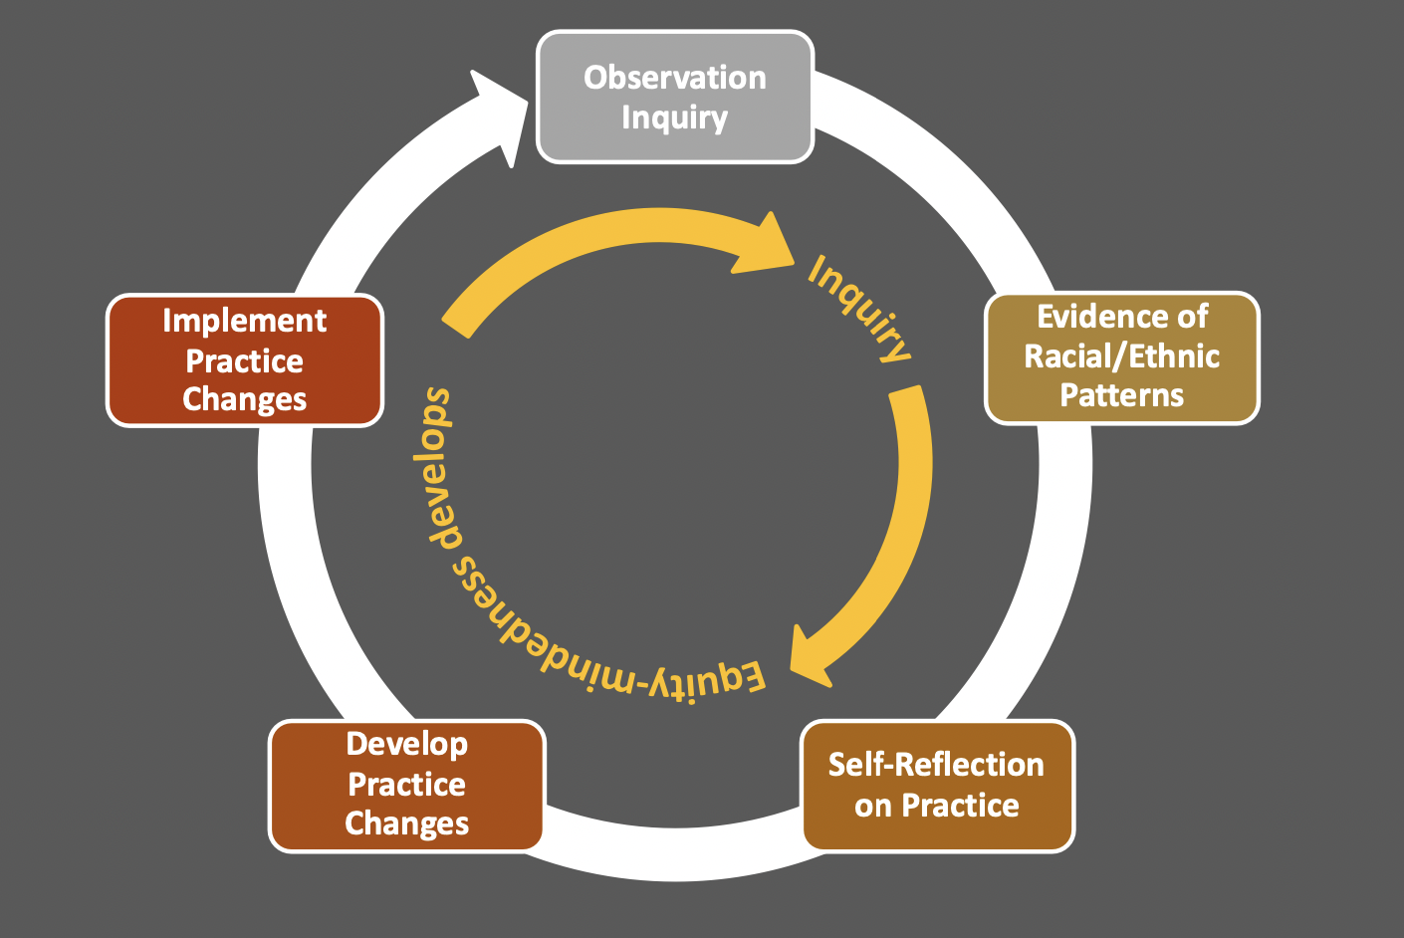
Developing Equity-Mindedness
Center for Urban Education (2020)
Notes:
Observation or Engagement inquiry can foster the development of practitioner equity- mindedness by:
Raising practitioner awareness of racial patterns and consequences;
Prompting self-reflection on practices;
Helping practitioners devise policy and practice changes that advance
racial/ethnic equity; and
Enabling practitioners to actively self-monitor interactions with
racially minoritized students.

Slide 9
Engagement Tool
Activity Goals
Examine how you welcome and build relationships with students
Bring awareness to which groups of students are more engaged, which do you pay more attention to, who speaks and who rewarded
Your “best guess” of each student’s racial/ethnic identity is appropriate here
Bensimon & Associates (2021) Racial Equity Data Discovery Workshop

Slide 10
Instructions
To the best of your ability, note students’ race/ethnicity, gender
Count number of times:
Students raise their hand
Students speak
Students you (instructor) speaks with
Also note:
Where you (instructor) walk in the room
Use of student name
Who is absent, leaves room, etc.

Slide 11
Bensimon & Associates (2021) Racial Equity Data Discovery Workshop
Notes:
This is what the race-conscious classroom assessment tool looks like (an example)

Slide 12
Step 1: Observe and Count
Notes:
The category of “Other” might also include negative points for not paying attention, leaving room, being disruptive, etc.

Slide 13
Step 1: Observe and Count
Group | Sex | Questions | Answers | Other | TOTAL
Latinx | Women
 | Men
Black | Women
 | Men
White | Women
 | Men
Asian | Women
 | Men
Bensimon & Associates (2021) Racial Equity Data Discovery Workshop

Slide 14
Step 1: Observe and Count
Group | Sex | Questions | Answers | Other | TOTAL
Latinx | Women |  |  |  | 1
 | Men |  |  |  | 1
Black | Women |  |  |  | 1
 | Men |  |  |  | 0
White | Women |  |  |  | 4
 | Men |  |  |  | 2
Asian | Women |  |  |  | 0
 | Men |  |  |  | 0
Bensimon & Associates (2021) Racial Equity Data Discovery Workshop

Slide 15
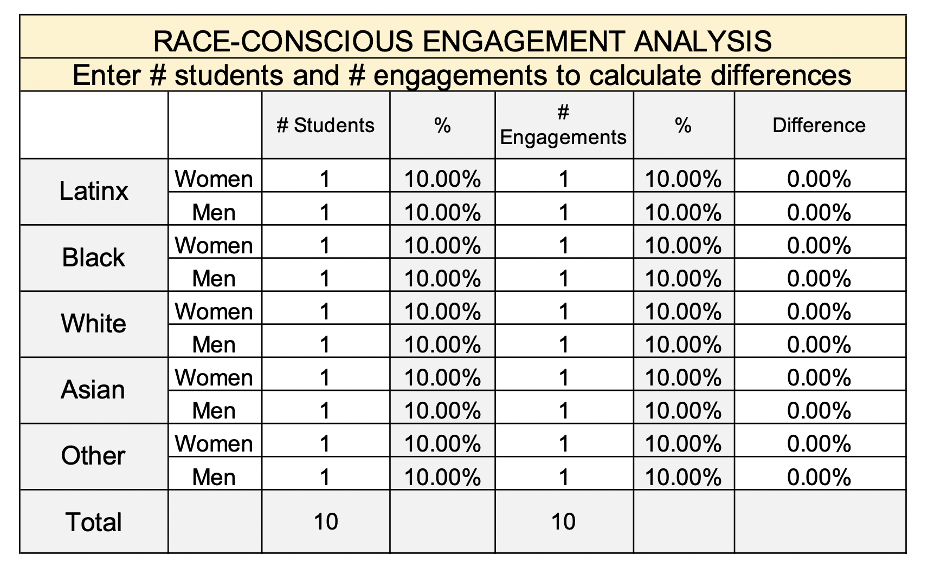
Step 2: Analyze
Bensimon & Associates (2021) Racial Equity Data Discovery Workshop
Notes:
Input the number of engagements and student racial/ethnic identities into the excel spreadsheet and it will calculate the “differences” column

Slide 16
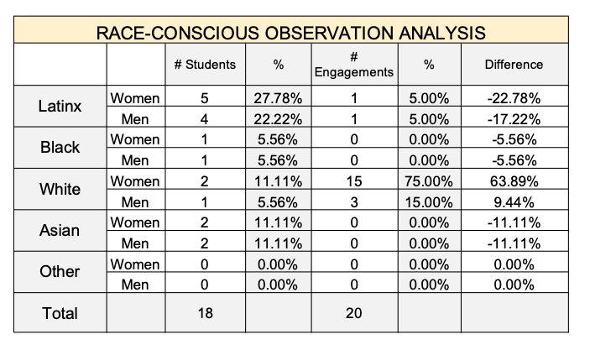
Step 2: Analyze
Bensimon & Associates (2021) Racial Equity Data Discovery Workshop

Slide 17
Step 2: Analyze
Bensimon & Associates (2021) Racial Equity Data Discovery Workshop

Slide 18
Step 3: Interpret
Notes:
Start to notice patterns in the data.

Slide 19
Step 3: Interpret

Slide 20
Example
1 Instructor: White female
18 Students: 9 Latinx, 4 Asian American, 3 White, 2 Black
Group | Sex | # | % | Engage | % | Difference
Latinx | Women | 5 | 27.8% | 1 | 5% | -22.8%
 | Men | 4 | 22.2% | 1 | 5% | -17.2%
Black | Women | 1 | 5.6% | -
 | Men | 1 | 5.6% | -
White | Women | 2 | 11.1% | 15 | 75% | +63.9%
 | Men | 1 | 5.6% | 3 | 15% | +9.4%
Asian | Women | 2 | 11.1% | -
 | Men | 2 | 11.1% | -
TOTAL |  | 18 |  | 20
Bensimon & Associates (2021) Racial Equity Data Discovery Workshop

Slide 21
Step 3: Self-Reflection
If there are patterns in the data, were you aware of them? Are they problematic?
Identify and label instances where you did and did not exhibit equity-minded practice.
What did this activity make you realize about the way you communicate with students in your classroom?

Slide 22
Step 4: Develop Changes
What are some ideas to make engagement with students more equitable?
What resources do we offer at Suffolk to help you, or help students?

Slide 23
Engagement Tool
Alternative Activities
Peer observation
Graduate Assistant observation
Zoom recording observation
Alternatives include the same steps:
Step 1: Observe and Count
Step 2: Analyze the Numbers
Bensimon & Associates (2021) Racial Equity Data Discovery Workshop

Slide 24
Building Equity-Mindedness
Embed equity-mindedness in practices and mindsets by:
Evidence-based (disaggregated data)
Race-conscious (bring awareness)
Institutionally focused (equity-minded strategies for improving practice)
Systemically aware (monitor disproportional impact)
Equity-advancing (set goals, communicate)
Center for Urban Education (2020)
Notes:
1. Building processes to regularly collect and review student outcome data disaggregated by race/ethnicity
2. Paying attention to whether or not racially minoritized students are participating, feel welcome, and succeed
3. Embedding inquiry and self-assessment as an ongoing strategy for improving practice, rather than only relying on interventions intended to “fix the student”
4. Monitoring whether policies or practices disproportionately impact some racial/ethnic groups
5. Setting goals to close equity gaps and collect data to monitor progress toward closing them, and communicating to the greater campus about equity gaps, inquiry findings, and actions to address gaps

Slide 25
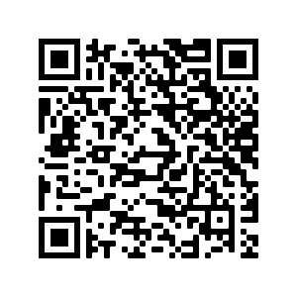
Summer Workshop
Wednesday July 20th, 2022
1:00 – 3:00 pm
On ZOOM
Tuesday August 16th, 2022
10:00 – 12:30 pm
Poetry Room w/ Lunch
Who succeeds and who stumbles in your classes?
----------
Using materials developed for the Racial Equity and Justice Institute, we examine past success rates through a race/ethnicity frame.
-----------
Bring along an individual or group assignment or project to examine in our discussion! Let us know if you would like a report of GPA for past semesters.

Slide 26
Suffolk DEI Curriculum Survey
Take the Spring 2022 Diversity Curriculum Survey to let us know more about your curriculum and course content:
https://tinyurl.com/SuffolkDEI
Or use this QR Code:

Slide 27
Appreciation
Thanks to Estela Bensimon and Associates for the framework!
Thanks to Joyya and the Suffolk REJI Group!
And…Thanks to you for being here!

